Slide 1
Canonical Forms

Slide 2
PDNF: Principle Disjunctive Normal Form

Slide 4
PCNF

Slide 8
Canonical form Conversion

Slide 9
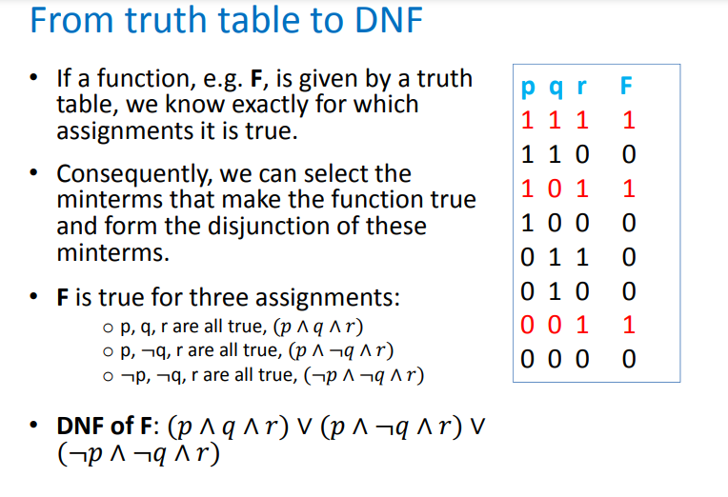

Slide 10
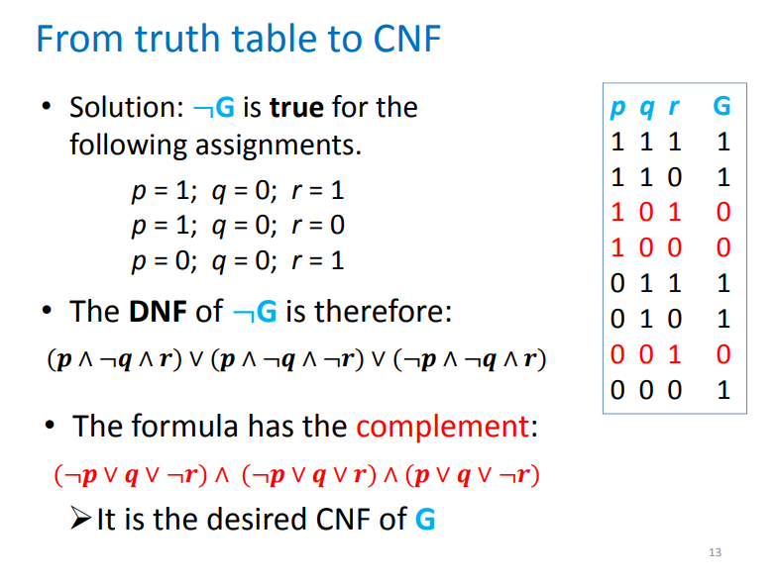

Slide 11
Ordering Canonical Forms

Slide 12
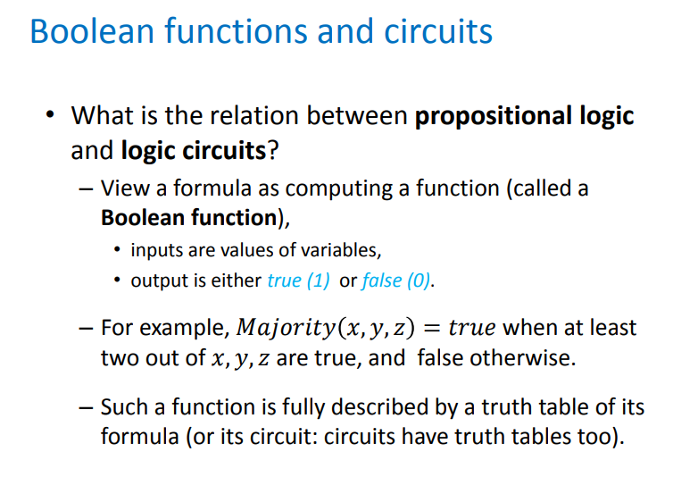
Boolean functions and circuits

Slide 13
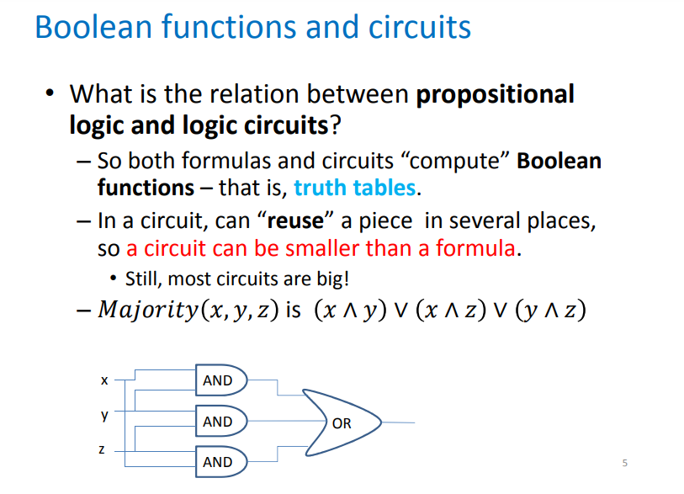

Slide 14
Assignment
Write a program to convert given formula into canonical form ?

